Slide 1
GE8151 Problem Solving and Python Programming
Rajasekaran S
Assistant Professor,
Department of Information Technology,
KGiSL Institute of Technology,
email: proffraja@gmail.com
Github:www.github.com/rajasekaranap

Slide 2
Functions
Functions is a set of codes that perform a defined operations.
It makes the program modular, reusable, readable.
Types of functions
Built in functions [comes with python library].
User defined functions [created by user].
Collection of functions makes modules

Slide 3
Functions
It is block of reusable code that performs specific task.
Provides Modularity and Reusability.
We can call anywhere, anytime in the program.
It also known as API’s.

Slide 4
Built in Functions [comes with python library]
Function | Description
abs() | Returns absolute value |N|
all() | Finds all the elements are true in a sequence
any() | Checks at least one element is true in a sequence
bin() | Converts Integer into Binary
int() | Converts string to integer
float() | Converts string to float
bool() | Converts the value to Boolean
chr() | Returns the ascii string of number passed
ord() | Returns the ascii value of character passed
dict() | Helps to create dictionary
hex() | Gives the hexadecimal representation of a number

Slide 5
Built in Functions [comes with python library]
Function | Description
input() | Returns the line of string
len() | Returns the length of objects [String, List, Tuple ... etc ]
list() | Creates and returns empty list
max() | Returns maximum value in sequence
min() | Returns minimum value in sequence
oct() | Converts to octal value from Integer
pow(x,y) | returns x to the power of y
round() | Rounds the float numbers to certain decimal points
slice() | Creates slice object specified by range
sorted() | It returns the sorted sequence
sum() | Returns sum of sequence
type() | Returns the type of element

Slide 6
User Defined Functions
User defined functions are created by the user.
It serves specific purpose to the user program.

Slide 7
Syntax for Creating Function
def function_name(parameters)
Statement 1
Statement 2
.
.
.
Statement N

Slide 8
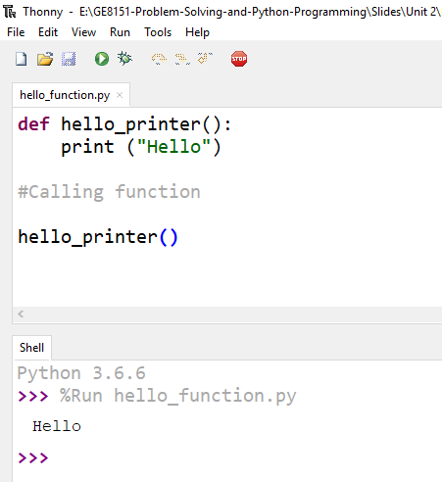
Hello World Function
keyword
Function Name
Parameter List
Function Body
Calling Function

Slide 9
Task
Have to use only one print statement
Print hello for 5 time without loop
Loop the call for 5 times
Get n value and print no of hello’s
Try some previous programs
Finding odd or even
Finding Area of the shape
Finding given year is leap or not

Slide 10
Task
Try some previous programs
Exchange values of the variables.
Circulate the values of n variables.
Guess a number in integer range.

Slide 11
Types of Functions
Based of Parameters
Functions without parameters
Function with parameters
Types of Arguments
Default Arguments
Keyword Arguments
Arbitrary Arguments

Slide 12
Thank You
Rajasekaran S
Assistant Professor,
Department of Information Technology,
KGiSL Institute of Technology,
email: proffraja@gmail.com
Github:www.github.com/rajasekaranap

